Slide 1
SENTIMENTAL ANALYSIS OF AUDIO USING NATURAL LANGUAGE PROCESSING
Supervisor :
Prof: Ms. Aida Jones
Assistant Professor (ECE)
Students Name :
1. M.Pavithra(311015106057)
2.S.R.Priyavardhini(31101510607)
3. S.Shripriya(311015106085)
Batch No: B6

Slide 2
Contents
Objective
Introduction
Technology and Tools
Block Diagram
Block Diagram Explanation
modules
Flow chart
Literature Survey
Comparison of reference papers
Results
Methodology comparison
Project poster
Journal details
References

Slide 3
OBJECTIVE
The main scope of this project is to understand human feelings and to determine their emotions whether it is positive ,negative or neutral using natural language processing(NLP).
To determine emotions in the audio and performs the Text and Tone analysis through the machine learning algorithm.
This is helpful in the organisation to analyse customer’s feedback for improving the product standard and quality.
This can also be used to analyze the movie reviews, social media reviews and the customer feedback.
To Improve the standard in a particular Area rather than checking overall process.
To develop product quality and Marketing.
This can be effectively used in Online commerce and advertising,Call centre,Market intelligence and the employee opinion.

Slide 4
INTRODUCTION
Sentimental analysis enables the computer to comprehend human emotions and make decisions based on those emotions.
The main scope of this project is understanding human feelings and determining the emotions using the natural language processing.
The emotions can be determined by getting the input voice from the customers and the and determine the emotions .
Background noise will be removed from the audio. The audio data will be transcribed into text using speech recognition system.
CATEGORY:
Text analysis: text pre-processing - Tokenization, Stemming, Stop words removal, Numbers removal and Lemmatization and Naïve Bayes algorithm for classification
Tone analysis: SVM (Support vector machine)
Emotion classification:1.Text analysis 2.Tone Analysis
Text Analysis : Positive , Negative , Neutral.
Tone Analysis : Happy, Sad, Fear, excitement.

Slide 5
TECHNOLOGY &TOOLS
Technology:
1. Natural language processing techniques
2. Speech Recognition System(speech to text)
3. Tone Analyser
Algorithm:
1. Naive Bayes for text classification
2. vader sentiment intensity analyser
3. support vector machine(svm) for the tone analysis
Domain:
1.Natural language processing
2.Machine learning
Software
1.Pycharm 2018.1.3 ,
2. Spyder 3.1 .
Language: Python

Slide 6
preprocessing
Positive,Negative,Neutral
Sentiment extraction
Audio input
speech to text convert
Tokenization
Naive bayes classisfier
Lemmatization
Telephone conversation
Lowercasing
Transcribing
Normalization
Stemming
Noise reduction
Stop words removal
Results
Special characters,Numbers removal
POSITIVE
TEXT ANALYSIS
NEGATIVE
NEUTRAL
TONE
ANALYSIS
Frequency &pitch of audio
Support Vector Machine(SVM)
Thersold values
Happy,sad,fear,excited,bored,
Angry
BLOCK DIAGRAM OF SENTIMENTAL ANALYSIS OF AUDIO USING NATURAL LANGUAGE PROCESSING

Slide 7
BLOCK DIAGRAM EXPLANATON
TEXT ANALYSIS:
The input will be the Audio data from the Telephone conversations.
Background Noise will be reduced from the input audio.
The audio will be converted into text and it will be stored .
After that text Pre-processing will be done followed by Tokenization ,stemming , Stopwords removal , Lemmization and numbers removal.
Naive Bayes algorithm is used for the classification purpose.
Support Vector Machine is used for the Tone Analysis of the Audio
TONE ANALYSIS:
After recorded the audio ,The Amplitude of audio crosses the particular frequency through the pitch the Tone is Analysed.
Mapping:
The output of the text and tone are analysed and mapped together to give the output of positive ,negative and neutral.
MAPPING:
The output of the text and tone are analysed and mapped together to give the output of positive ,negative and neutral.

Slide 8
MODULES
Module 1- SPEECH ANALYSIS AND TRANSCRIBING
The input will be telephone conversation audio . It will converted into text through speech recognition module.
Module 2- NOISE REDUCTION
filters applied
Cutoff frequency
Module 3-TEXT ANALYSIS
Preprocessing
Lowercasing
Normalization
Stop words Removal
Module 4-TONE ANALYSIS
Data sets of emotions
Support vector machine
Module5-MAPPING AND RESULTS
Mapping the text and tone analysis output
Positive ,Negative, Neutral.

Slide 9
TEXT ANALYSIS
SPEECH RECOGNITION
Speech Recognition is a process in which a computer or device record the speech of humans and convert it into text format. It is also known as Automatic Speech Recognition (ASR)
Implementing Speech Recognition in Python is very easy and simple. Speech recognition.
PYTHON LIBRARY
1.Speech Recognition
2.pyaudio
These Speech Recognition and Pyaudio are the library in the python to perform the operations like speech recognition, speech to text and also it helps to recognize the human voice and performs speech to text etc. The Pyaudio is the one of the library used to access the audio file.
PREPROCESSING
Data preprocessing is an important step in the data mining process. The phrase "garbage in garbage out” is particularly applicable to data mining and machine learning projects
1.Tokenization
2. Lowercasing
3. Normalization
4. Stop words removal
5. Special characters removal

Slide 10
TONE ANALYSIS
Identifying a human based on the variations and unique characteristics in the voice is referred to speaker recognition. It has acquired a lot of attention from the research community for almost eight decades.
The extraction of unique speaker discriminant feature is important to achieve a better accuracy rate
SUPPORT VECTOR MACHINE:
Feature Extraction:
The extraction of unique speaker discriminant feature is important to achieve a better accuracy rate. The accuracy of this phase is important to the next phase, because it acts as the input for the next phase.
Subjectivity dataset:
It is a dataset containing the list of positive
and negative words. Subjectivity expresses some personal feelings, opinions, views, or beliefs.
Polarity classifiers:
The polarity analysis deals with the identification of amount of positive and negative terms that appears in a sentence. The polarity can be broadly classified into Positive polarity item (PPI) and Negative polarity item (NPI).

Slide 11
Parameters | Text analysis | Tone analysis
THERSOLD VALUE POSITIVE | Polarity >= 0.5 ; Text is positive | Frequency <=0.10 classification: fear,bored
THERSOLD VALUE NEGATIVE | Polarity<= -0.5; Text is negative | Frequency >=0.15 classification: angry ,sad
THERSOLD VALUE NEUTRAL | Polarity == 0;Text is neutral | freq == 0.20 classification: happy,excited
ALGORITHM | 1. Naive Bayes 2. Vader sentiment Intensity Analyser | Support Vector Machine(SVM)
RESULTS | 1. Positive 2. Negative 3. Neutral | 1. Happy 2. Sad 3. Angry 4. Bored 5. Excited 6.Fear

Slide 12
FLOW CHART OF SENTIMENTAL ANALYSIS
AUDIO DATA
NOISE REMOVAL
Tone Analysis
Text Analysis
Pitch and frequency of audio
Normalization
Support vector machine(SVM)
Data Preprocessing
Thersold values
Naïve Bayes classifier
Happy, sad,fear,excitement
digust
Postive, Negative,Neutral
Mapping
POSITIVE
NEGATIVE
NEUTRAL

Slide 13
LITERATURE SURVEY BASE PAPER
[2.1]Lakshmish,Kaushik,Abhijeet,Sangwan,John,H.L.Hansen “sentiment extraction from natural audio streams”, International Conference on Science and Technology 2014.
PRINCIPLE:
The Input will be Audio data set.
Algorithm used is Maximum Entropy and Naïve Baiyes.
Audio converted into Text and processed.
The results will give the percentage of positivity , Negativity and Neutral in Audio.
MERITS:
The technology maximum entropy gives the accurate sentiments.
Many Data set can be analysed
Semantic Sentiment estimation model .
Maximum Entropy Modelling used.
SVM technique enhances the accuracy.
DEMERITS
Natural spontaneous speech data despite poor WER (word error rates).
Supports only language English.

Slide 14
REFERENCE PAPERS
[2.2] Preedawon , Kadmateekarun , Sumitra , Nuanmeesri “Emotion Recognition on The Basis of Audio Signal Using Naive Bayes Classifier” ,International Conference on Science and Technology 2015, RMUTT.
MERITS:
Techniques for modelling and analyzing several variables.
Naïve bayes classification using Audio dataset.
DEMERITS:
In the speech signal for recognition of signal classifier require millions of dataset.
[2.3]Min Zhao,TaoZhenZhang,Jianping Chai ”Based on SO-PMI Algorithm to Discriminate Sentimental Words’ Polarity in TV Programs’ Subjective Evaluation”,International Symposium on Computational and Design 2015
MERITS:
Text mining is the technology to analyze the massive data
Polarity and calculating sentimental words’ intensity based on SO-PMI algorithm and sentimental analysis technology.
DEMERITS:
Division of static emotional words and dynamic emotional words are difficult.

Slide 15
[2.4] Maghillnan ,Rajesh Kumar ”Sentiment Analysis on Speaker Specific Specific data”, 2017 International Conference on Intelligent Computing and Control (I2C2)
MERITS:
Twitter dataset, product review dataset are used to commute the accuracy of the system.
.The process involves four steps: 1) Pre-processing which includes VAD, 2) Speech Recognition System, 3) Speaker Recognition System, 4) Sentiment Analysis
DEMERITS:
Extracting the tweets is difficult.
Processing time is more.
[2.5] Sagar K.Bhakre, Prof .Arti Bang ”Emotion Recognition on The Basis of Audio Signal Using Naive Bayes Classifier”, 2016 International Conference on Advances in Computing, Communications and Informatics (ICACCI)2016
MERITS:
The advantage of Naïve Bayes classifier is that it recognizes the signal with minimum dataset.
DEMERITS:
Speech signal is random signal so we have to predict the future sample.
Complex Algorithm are used.

Slide 16
Paramaters | BASE PAPER | PAPER 1 | PAPER 2 | PAPER 3 | PAPER 4 | PAPER 5
OBJECTIVE | Analysing product based reviews in social Media | Uses natural audio stream as a Input data for Analysing | To find contextual polarity and emotions | Find emotions based on subjectivity | Processes the call center data for company to analyse feedback | For speaker specific speech data
TECHNOLOGY | Naive bayes & support vector machine | Baseline and without noun systems | Neutral polar classification and vector | Minimum cut based approach | Keyword extractor & SVM key graph | MFTC & dynamic time wrapping
PRO’S | Find opinions of users | For natural You tube speech | Gives result as polar or neutral | Subject oriented output and percentage of emotions | Clustering is easy | Quick process in mapping
CON’S | Has problem of different slangs | Words and phrase analyse is difficult | Suppress subjectivity identification | Suppress polarity identification | Loss during translation | Flaws in speech affect mapping

Slide 17
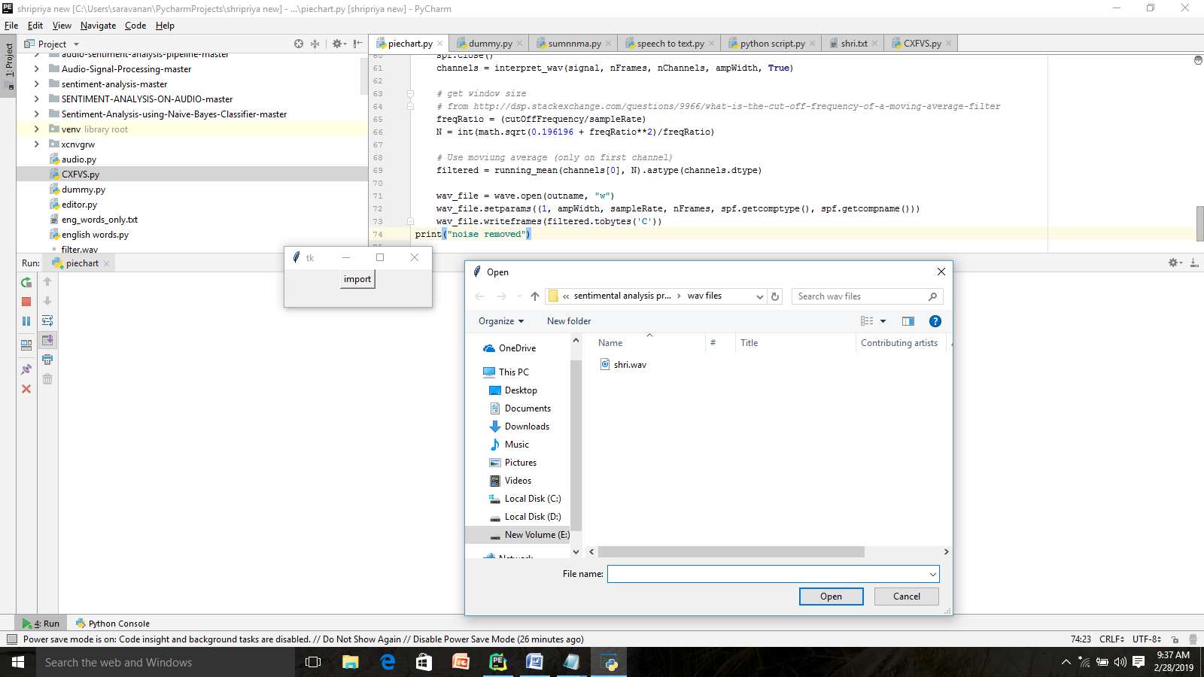
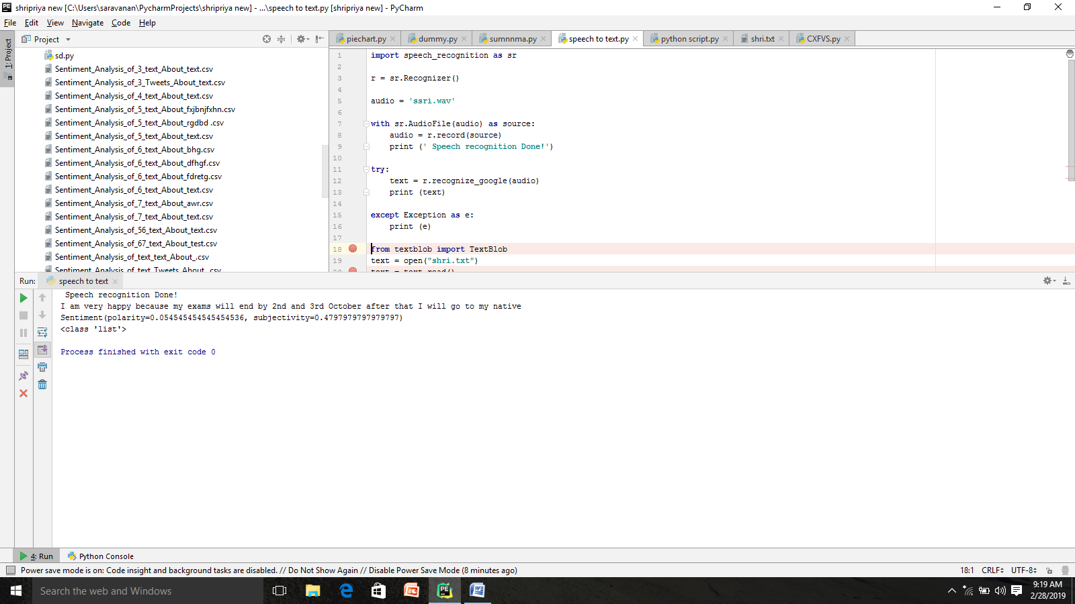
SENTIMENTAL ANALYSIS OF AUDIO USING NATURAL LANGUAGE PROCESSING
1. BACKGROUND NOISE REDUCTION
2. SPEECH RECOGNITION (SPEECH TO TEXT)

Slide 18
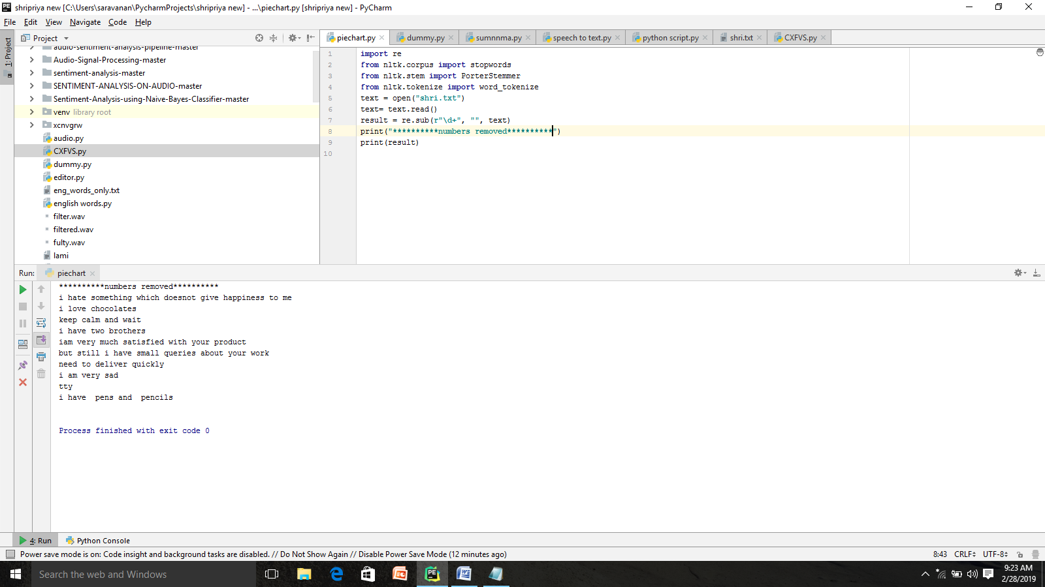
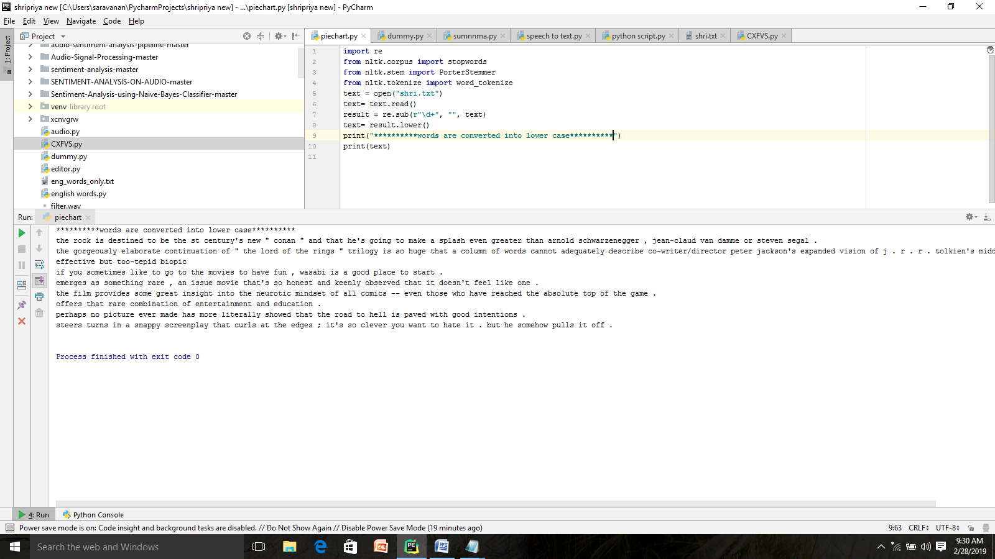
TEXT ANALYSIS
3. NUMBERS REMOVAL
4. LOWER CASING

Slide 19
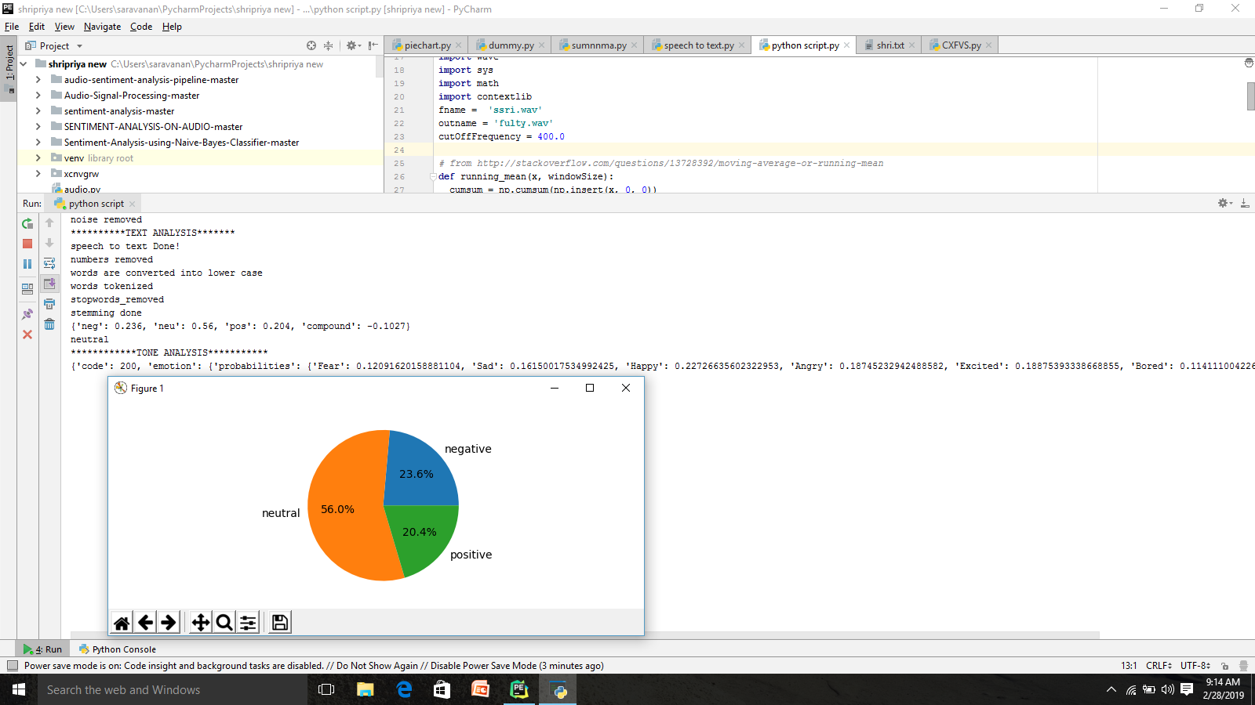
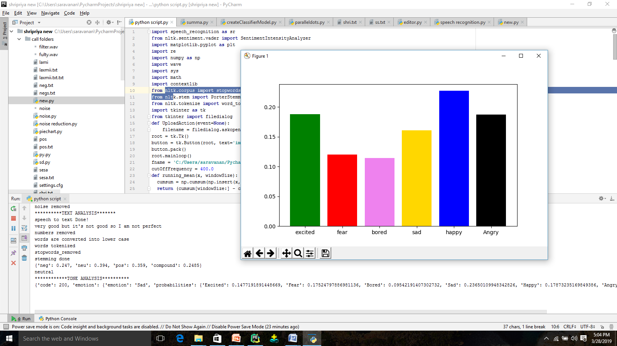
7. TEXT ANALYSIS RESULT
8. TONE ANALYSIS RESULT

Slide 20
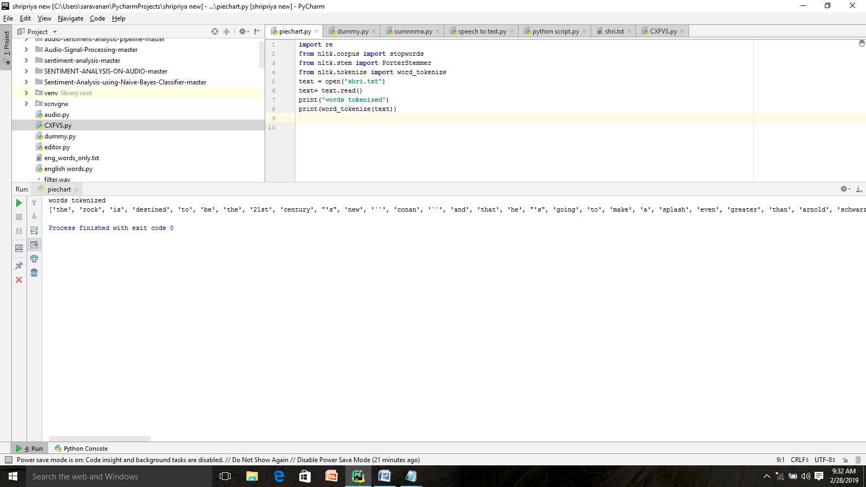
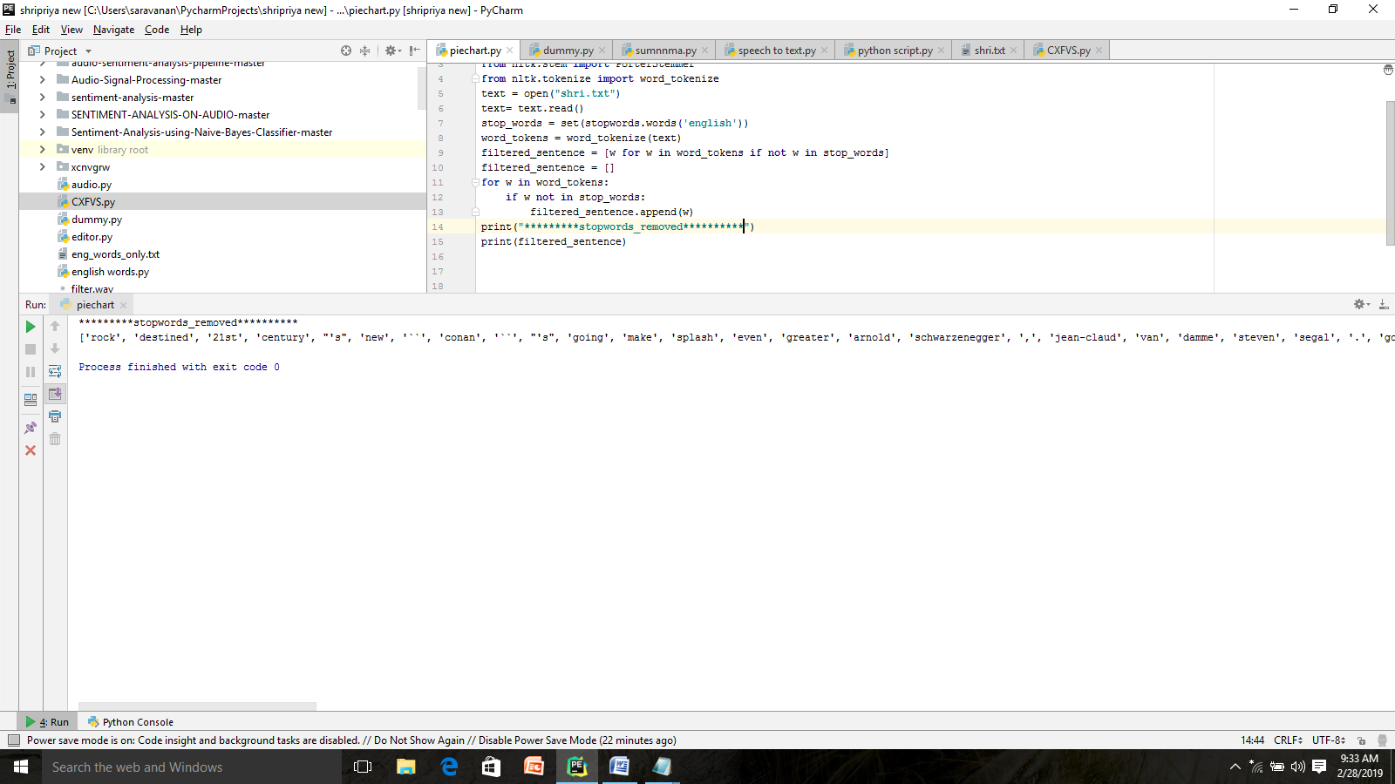
5. TOKENIZATION
6. STOPWORDS REMOVAL

Slide 21
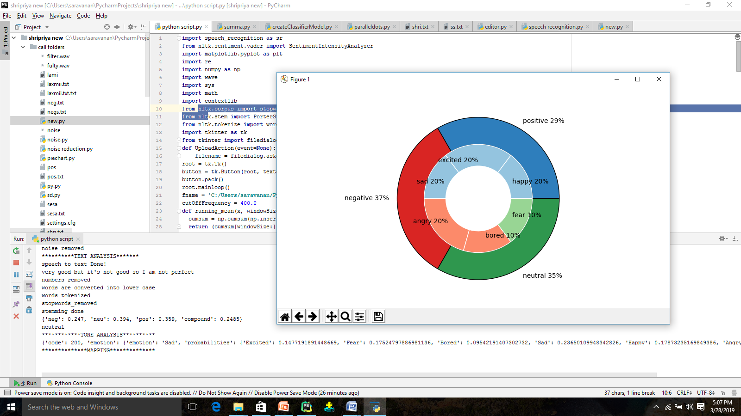
9.FINAL MAPPING RESULTS

Slide 22


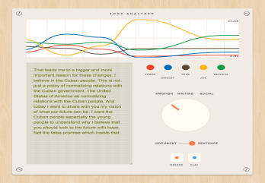
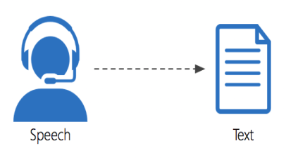
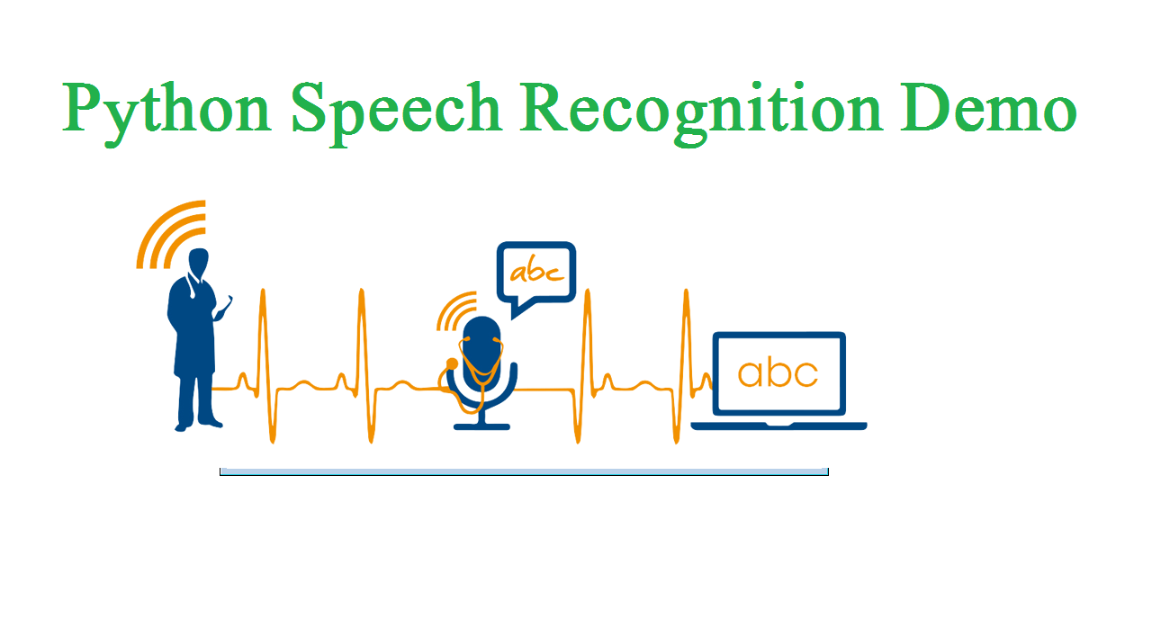
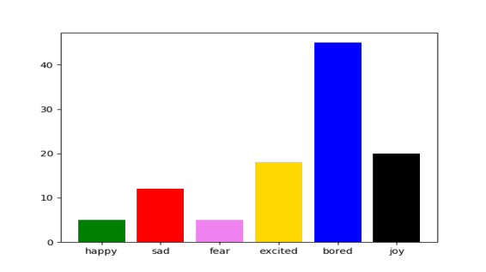
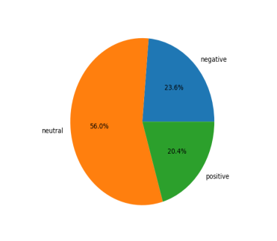
SENTIMENTAL ANALYSIS USING AUDIO (NLP)
INTRODUCTION
Sentimental analysis understands human emotions.
This uses the natural language processing to process voice data.
The emotions can be determined by getting the input voice from the customers and the and determine the emotions
To Improve the standard in a particular Area
To develop product quality and sales.
OBJECTIVE
To understand human feelings and to determine their emotions whether it is positive ,negative or neutral using natural language processing(NLP).
To determine human emotions in the audio.
To analyse their feedback for improving the product standard.
To Improve the standard in a particular Area
To develop product quality and sales.
DONE BY:
NAME:M.PAVITHRA
S.R.PRIYAVARDHINI
S.SHRIPRIYA
MENTOR:MS.AIDA JONES
BATCH NO:B6
METHODOLOGY
Speech recognition system transcribes the audio to text
Input will be telephone conversation audio.
For identifying feedback of product.
Pre processing methods are Tokenization
stemming ,stop words removal , Lemmization and numbers removal.
After that text Pre-processing done followed by Naive Bayes algorithm is used for the classification purpose..
The emotions can be determined as positive ,negative and neutral.
RESULTS
The output of text analysis is positive negative and neutral and the output of tone analysis is happy sad angry fear etc
These two output combined to form the emotional output
FUTURE SCOPE
The future scope will be analyzing it with big data set.
Gender of the speaker can be identified.
Many languages can be used
Software: Pycharm 2018.1.3 ,Spyder
Algorithm: Naive Bayes
Language: Python

Slide 23
JOURNAL DETAILS
Pavithra M,Priyavardhini S R,Shripriya S.”INTERNATIONAL JOURNAL OF ENGINEERING AND TEVHNIQUES(IJET),ISSN 2395-1303.MARCH 2019(APPROVED)

Slide 24
References
1.Lakshmish Kaushik, Abhijeet Sangwan, John H.L.Hansen “sentiment extraction from natural audio streams”, International Conference on Science and Technology 2014.
2.PreedawonKadmateekarun, Sumitra Nuanmeesri “Emotion Recognition on The Basis of Audio Signal Using Naive Bayes Classifier” ,International Conference on Science and Technology 2015, RMUTT
3. ]Min Zhao, TaoZhenZhang, Jianping Chai ”Based on SO-PMI Algorithm to Discriminate Sentimental Words’ Polarity in TV Programs’ Subjective Evaluation”,International Symposium on Computational Intelligence and Design 2015
4. Maghilnan ,Rajesh Kumar ”Sentiment Analysis on Speaker Specific Specific data”, 2017 International Conference on Intelligent Computing and Control (I2C2)
5. [2.6] Sagar K. Bhakre, Prof.Arti Bang ”Emotion Recognition on The Basis of Audio Signal Using Naive Bayes Classifier”, 2016 International Conference on Advances in Computing, Communications and Informatics (ICACCI)2016
6. Souraya Ezzat, Neamat El Gayar, and Moustafa M. Ghanem “Sentiment Analysis of Call Centre Audio Conversations using Text Classification”

Slide 25
7. Lakshmish Kaushik, Abhijeet Sangwan and John H. L. Hansen “Automatic Sentiment Detection in Naturalistic Audio”, Center for Robust Speech Systems (CRSS), Eric Jonsson School of Engineering and Computer Science, The University of Texas at Dallas, Richardson, Texas, U.S.A.
8. Souraya Ezzat, Neamat El Gayar, Moustafa M. Ghanem, “Sentiment Analysis of Call Centre Audio Conversations using Text Classification”
9. Erik Cambria, Catherine Havasi, Amir Hussain, “SenticNet to a Semantic and Affective Resource for Opinion Mining and Sentiment Analysis”
10.TheresaWilson, JanyceWiebe, Paul Hoffmann, “Recognizing Contextual Polarity in Phrase-Level Sentiment Analysis”
11. Bo Pang, Lillian Lee, “A Sentimental Education: Sentiment Analysis Using Subjectivity Summarization Based on Minimum Cuts”
12. Subramaniam.G, Aswini.R, Ranjitha.M, .Ruchi Mehra, Mandeep Kaur Bedi, Praveen Kumar rajendran “Survey on User Emotion Analysis using Twitter Data”

Slide 26
THANK YOU

